Slide 1

Building User-Friendly Document Automation
Quinten Steenhuis, Greater Boston Legal Services
Twitter: @QSteenhuis / nonprofittechy.com

Slide 2

Who am I?

Slide 3
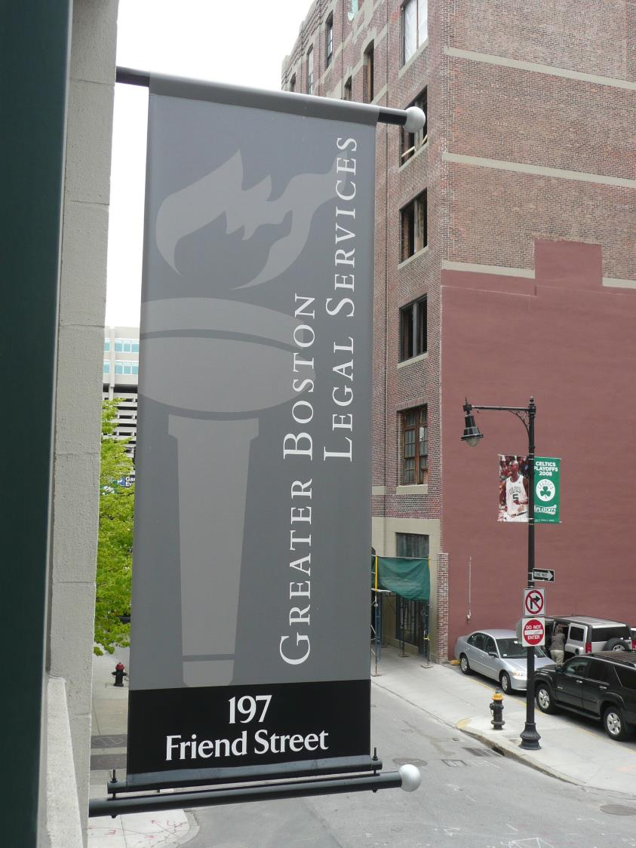
Who is Greater Boston Legal Services?
Founded in 1900
2 Offices: Boston and Cambridge
About 120 full-time staff
Civil legal aid (non-criminal)
We serve indigent clients in 32 cities and towns (125% of Poverty level)

Slide 4

Overview of Document Assembly
The Housing Unit’s Problem
Demo of a Solution
Principles for User-friendly Design
Workshop

Slide 5
Why Automate Documents?
Save time
Improve “correctness”
Empower non-experts
Solve problems at scale

Slide 6

Anna’s Story

Slide 7
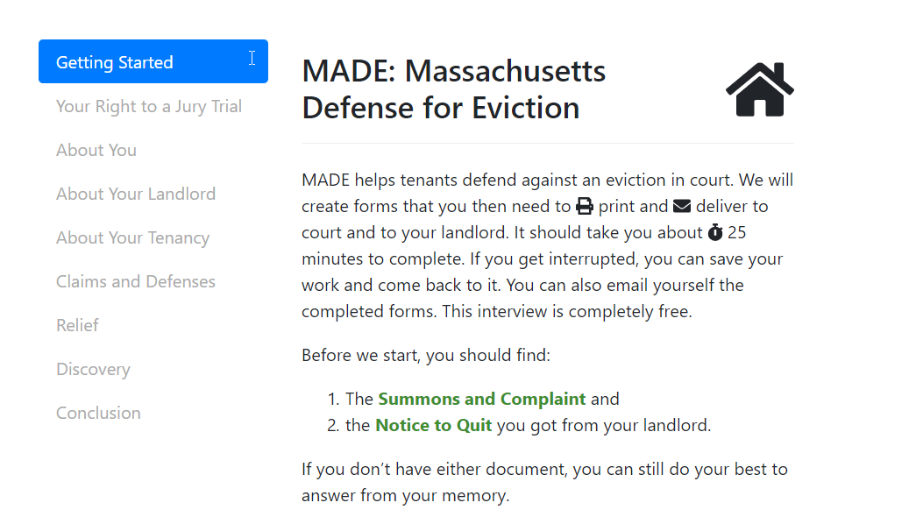
Demo

Slide 8
7 Principles for Smart Guided Interviews
“Dumb” forms are not worth the work
Ask users to state facts, not conclusions
Use visuals
Do the work for the user
Get it right or don’t automate
Give help in context
Test, test, test and iterate, iterate, iterate

Slide 9
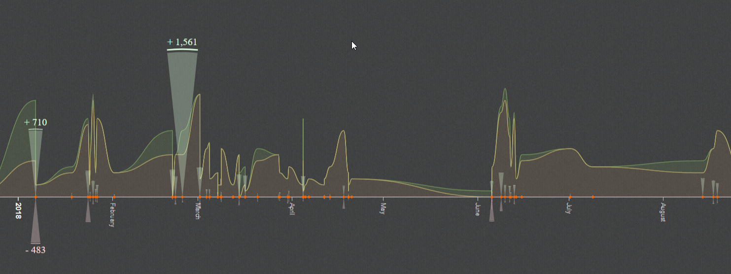
Additions, Deletions, REvisions

Slide 10
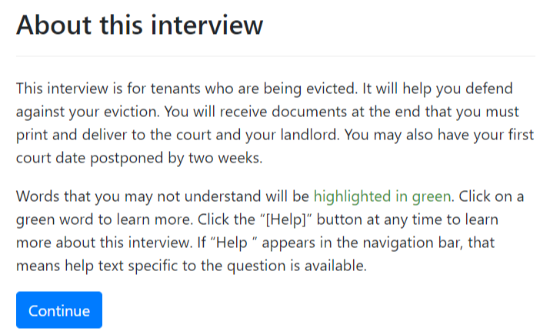
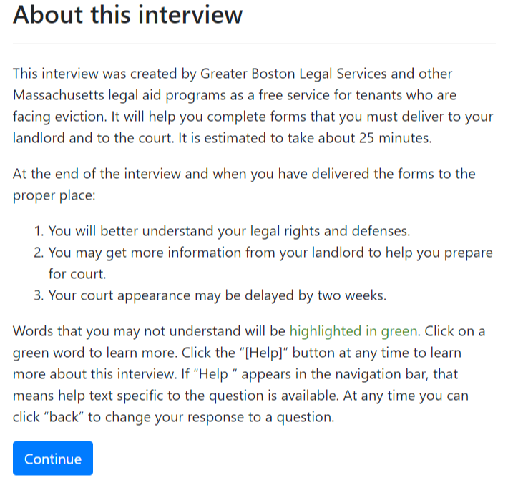
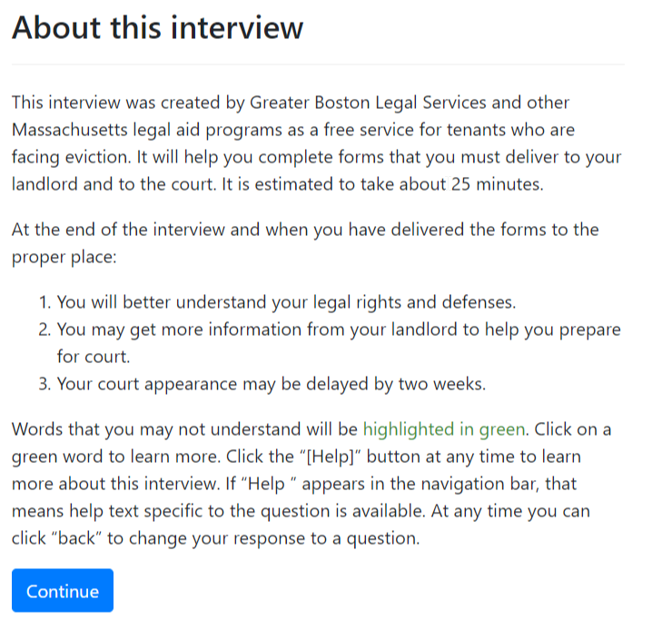
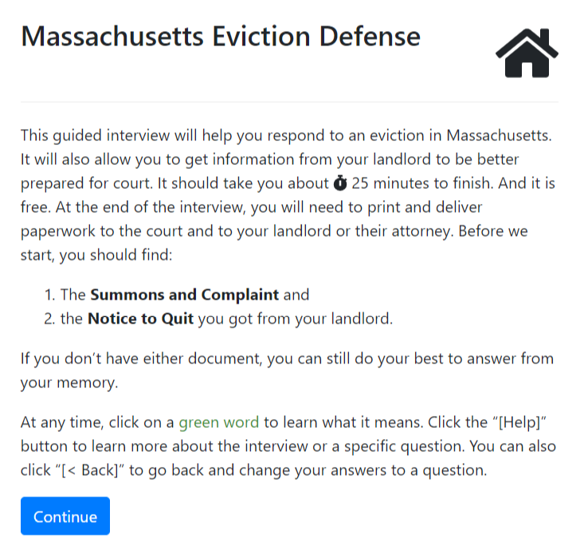
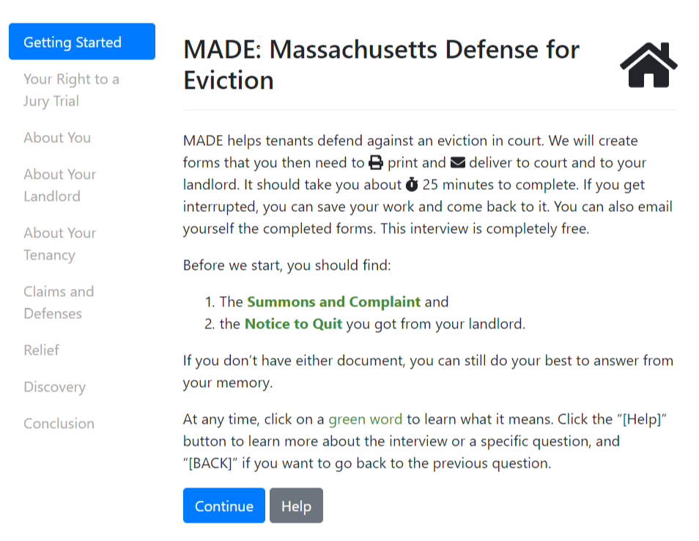

Slide 11
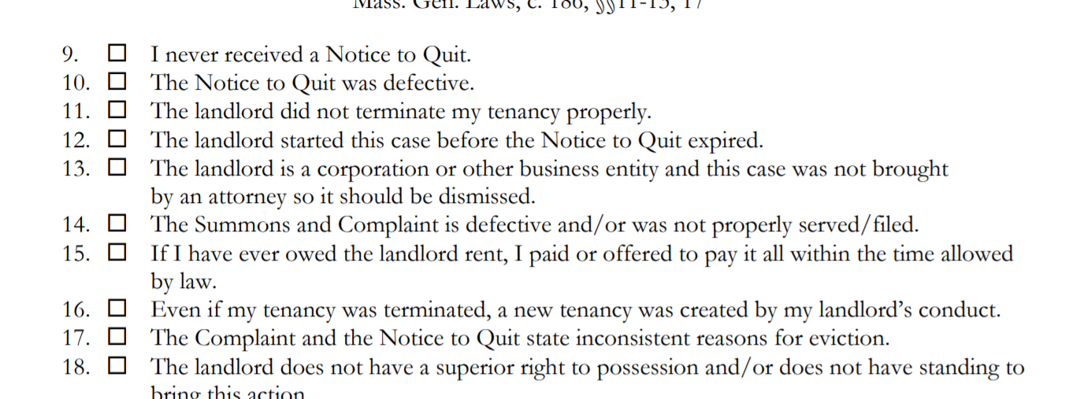
“10 Impossible Questions”

Slide 12

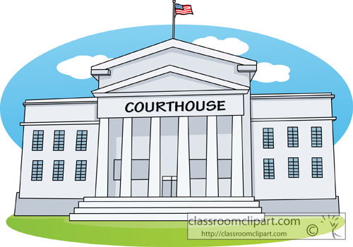
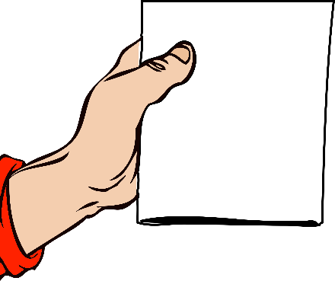
Notice to Quit:
Ends tenancy.
3, 14, or 30 days
Lease/law may require special language
Summons
and Complaint:
Begins eviction.
Filed after Notice
expires
Hearing in Court
Notes:
Simplified eviction timeline

Slide 13
Breaking Down Question 11
Tenancy was not properly terminated if:
Notice to quit is defective or
Wrong type of notice given
Wrong amount of time provided on notice
A notice to quit was required, but not given
Notice to Quit is Defective if:
Does not include the name of all tenants or
Has the wrong address
Doesn’t include any special language (e.g., required by subsidy rules)

Slide 14
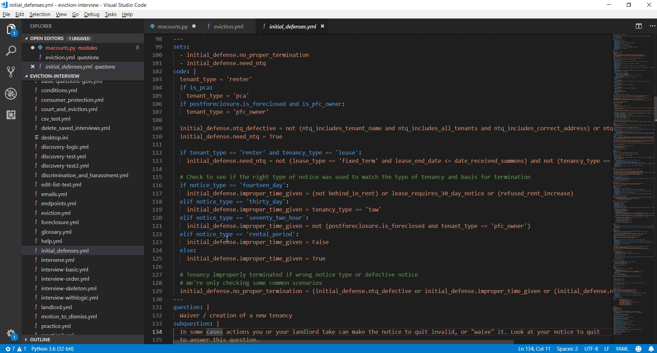

Slide 15
Demo

Slide 16
Hello, World: Try out some Docassemble
GBLS’s development server: https://interviews-dev.gbls.org
Sign in
Username: demo1@demo.com … demo8@demo.com
Password: check the Slack channel
Menu | Playground

Slide 17
Unofficial Stretch Goals
Create a letter to Santa on Docassemble
Add a kind of field we didn’t review: dropdown, date, etc.
Add an image
Use Markdown syntax to add some formatting to the letter (bold, headlines, etc)
Learn how to format a Docx template file (keep in mind it uses Jinja tags instead of Mako tags)

Slide 18

More Information
Fork us on GitHub
@Nonprofittechy @GBLSMA https://github.com/GBLSMA/docassemble-MAEvictionDefense
Docassemble Tutorial at
https://gblsma.github.io/docassemble-MotionTutorial/
or http://bit.ly/2DKyZby
Web: Nonprofittechy.com Twitter: @QSteenhuis

